Slide 1
Detecting Anomalies in UNISUP Procurement Data Using Unsupervised Machine Learning
ENOCH,MIODINI
UNISUP Coordination
June 2024
Notes:
Please make sure to write the name of the Brand with the right spelling: TotalEnergies.
TotalEnergies is a single name, in the plural, written with no spaces, all one word, with an “s” at the end of the word, Upper case “T” and “E”, lower case for other letters, and without an accent.
It’s not permitted to write the name of the Brand as follows:
Total Energies (with a space)
totalenergies
total energies
Totalenergies
Total energies
totalEnergies
total Energies
TOTALENERGIES
TOTAL ENERGIES

Slide 2
Outline
Executive Summary
Introduction
MRP Approval Process
Possible Anomaly Detection Scenarios
Methodology
Results
Explainable AI(xAI): Feature Importance Analysis
Model Evaluation
Conclusion
Next Steps
References

Slide 3
Executive Summary
The company depends on efficient procurement processes to ensure operational continuity and cost-effectiveness. However, anomalies in procurement data, such as fraudulent transactions and irregular purchasing patterns, pose significant risks. Detecting these anomalies in a timely manner is crucial for mitigating such risks. As company seeks to streamline their processes, eliminate inefficiencies, and reduce risks, AI-leveraged automations have emerged as a game-changer in this area. This study explores the application of unsupervised machine learning techniques to detect anomalies in procurement data from the UNISUP ERP system. Some data features were engineered based on subject matter expertise and company policies for best practices in procurement of stocked materials. We applied and compared several machine learning models to unlabeled dataset obtained from a combination of relevant procurement tables. To ensure a robust evaluation of the models in the prediction of anomalies on the unlabeled dataset, we utilized the time Distributed Stochastic Neighbor Embedding (t-SNE) visualizations to assess the clustering and separation of anomalies. The results showed that Isolation Forest, Sine Cosine Algorithm(SCA)-Optimized K-Means and Ensembled model provided the highest performance, with clear separation and minimal overlap of anomalies. Explainable AI (xAI) techniques, specifically permutation importance, were employed to identify key features influencing anomaly detection. The findings contribute to enhanced risk management and decision-making in procurement operations, supporting the company in maintaining the integrity of her procurement processes.

Slide 4
Introduction
The objective of this work is to develop a labelled dataset using artificial intelligence. The dataset will be used to training models to predict future purchasing as normal or abnormal. The model will serve as intelligent control system and a handy tool for the auditor for procurement of stock materials thus, proactively preventing risk in procurement.
Problem Statement:
The UNISUP system, generates vast amounts of procurement data, including purchasing transactions, material consumption history, material storage, and master data. Given the high dimensionality and complexity of this data, manual inspection for anomalies is impractical and inefficient. Traditional rule-based approaches are often inadequate, failing to adapt to evolving patterns and new types of anomalies.
To address these challenges, this project aims to apply and compare various unsupervised machine learning techniques for anomaly detection in UNISUP procurement data. The goal is to label the dataset for anomalies, enabling future prediction of out-of-sample purchasing data as normal or abnormal.
Specifically, this project seeks to answer the following questions:
1) Which unsupervised anomaly detection model provides the highest accuracy and reliability in identifying anomalies in SAP ERP procurement data?
2) How can t-SNE visualization be utilized to effectively evaluate the clustering and separation of anomalies detected by each model?
3) What are the key features influencing the detection of anomalies, and how can Explainable AI techniques, such as permutation importance, enhance the interpretability of the results?

Slide 5
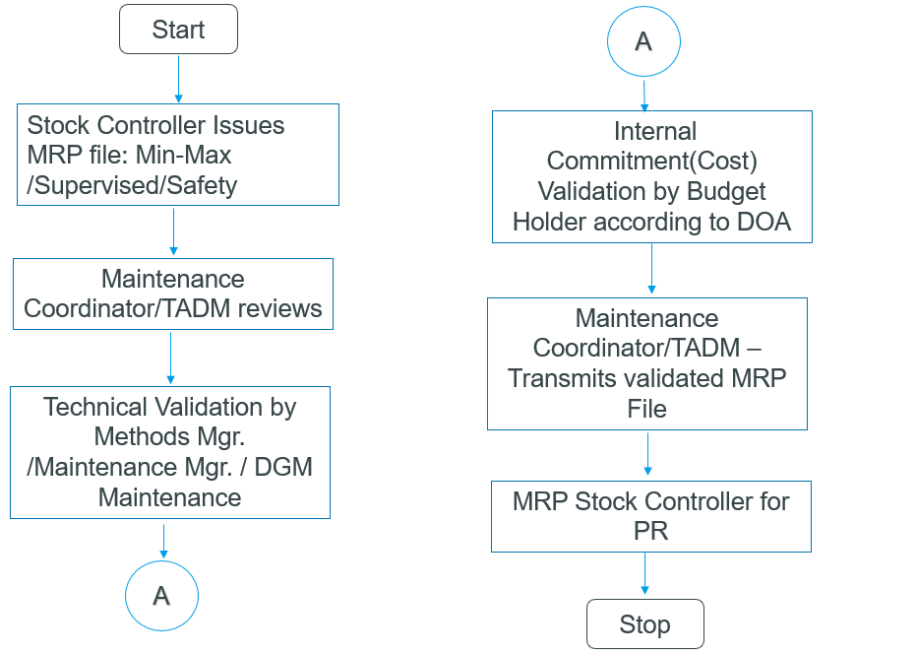
MRP Approval Process

Slide 6
Possible Anomaly Detection Scenarios
Scenario | Detection | Implication
Unusual Purchase Frequencies | Monitoring the frequency of orders against historical purchasing patterns can highlight anomalies. | Overfrequents ordering could indicate system errors, potential overstocking, or even fraudulent activities aiming to bypass approval thresholds.
Unexpected Supplier Changes | Analyzing procurement reports to identify new or rarely used suppliers. | Sudden changes without a clear rationale could suggest fraud, supplier kickbacks, or a lack of compliance with procurement policies
Non-standard Materials | Identifying orders for materials not typically used in the company’s operations. | Ordering non-standard materials could signify errors, miscommunications, or potential misuse of company resources.
Price Anomalies | Comparing purchase prices to historical data, market rates, and contract prices. | Significant deviations can indicate pricing errors, fraud, or market volatility. It necessitates thorough investigation to prevent financial losses.
Budget Deviations | Comparing order values against departmental or project budgets. | Exceeding budgets without proper authorization can indicate a lack of financial control and oversight, leading to budgetary overruns and financial mismanagement
Duplicate Orders | Identifying multiple orders for the same material within a short timeframe. | Duplicate orders can result in overstocking, increased holding costs, and potential waste. It might also indicate process inefficiencies or intentional fraud.
Rapid Stock Depletion | Monitoring inventory levels and turnover rates | Frequent reorders for materials that should not deplete quickly might suggest theft, poor inventory management, or errors in tracking systems

Slide 7
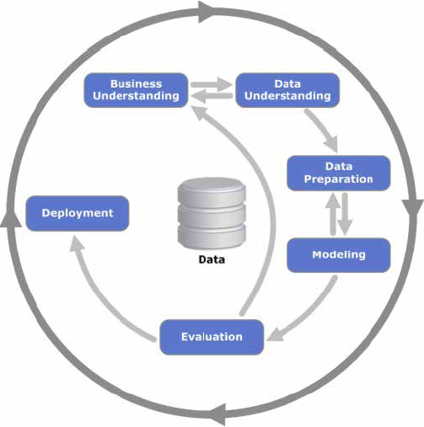
Project Methodology
We will be applying the Cross-Industry Process for Data Mining (CRISP-DM) methodology.

Slide 8
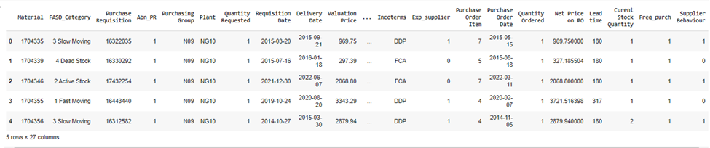
Project Methodology
Data Acquisition and Understanding:
The data was collected using a combination of SAP tables that store purchasing transactions, material consumption history, material storage, and master data. These tables were integrated to create a comprehensive dataset for analysis.

Slide 9
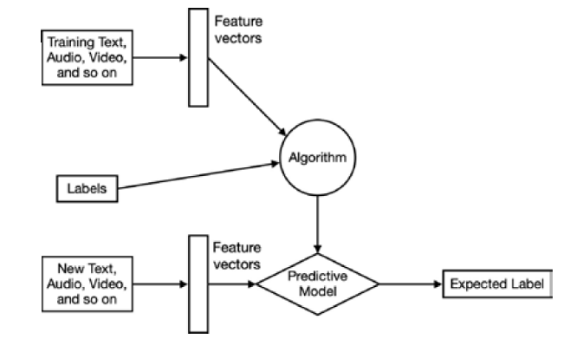
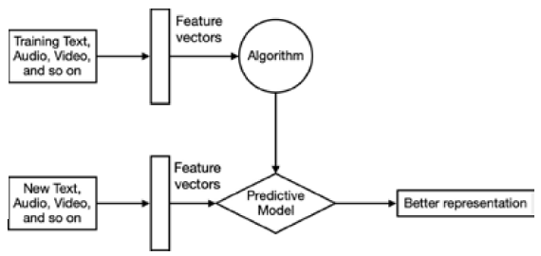
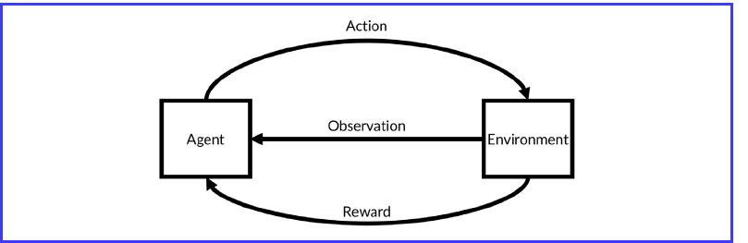
Project Methodology
Machine Learning Models: The dataset was subjected several unsupervised models are to label data points as normal or abnormal
Supervised Learning Unsupervised Learning
Reinforcement Learning

Slide 10
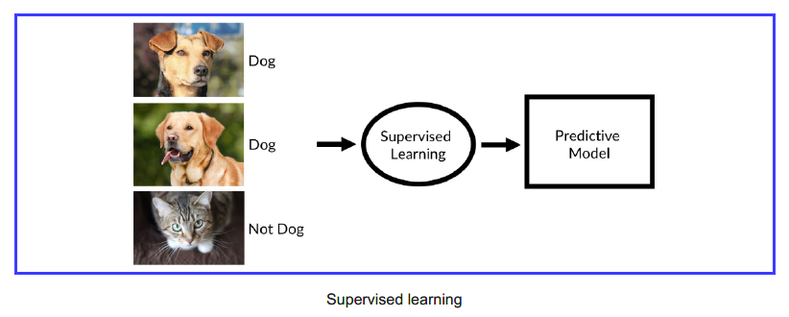
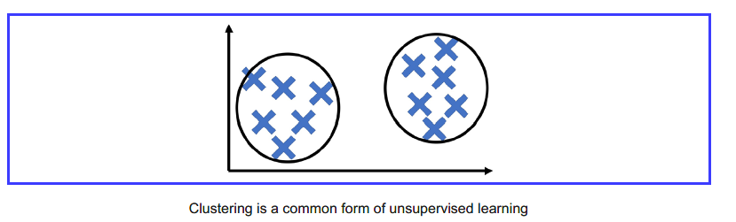
Project Methodology
Machine Learning Models
Applications of AI in Finance
Fraud Detection: Identifying suspicious activities in real-time.
Risk Management: Predicting and managing financial risks.
Algorithmic Trading: Executing trades based on data analysis.
Customer Service: Using chatbots for customer inquiries.
Credit Scoring: Evaluating creditworthiness using diverse data.
Portfolio Management: Robo-advisors for personalized investment advice.
Financial Forecasting: Predicting market trends and stock prices.
Regulatory Compliance: Automating compliance and reporting.
Insurance: Assessing risks and detecting fraudulent claims.
Personalized Financial Planning: Providing tailored financial advice.
10

Slide 11
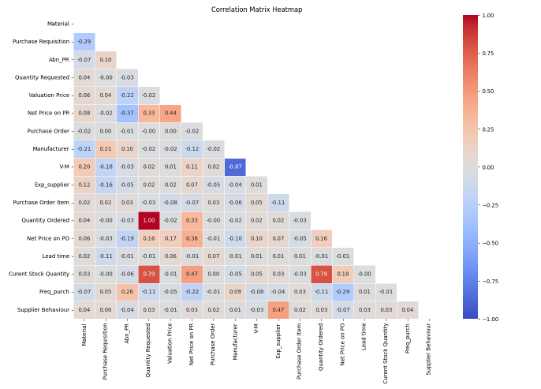

Data Wrangling, Exploration and Preparation
Features Correlation Map
Standardization:
The data was standardized using StandardScaler to ensure all features had a mean of 0 and a standard deviation of 1.

Slide 12
Results
Model | Anomaly Detected
Isolation Forest | 140
LOF | 11
Autoencoders | 140
K-Means | 140
SCA-K-Means | 49
Ensemble | 397

Slide 13
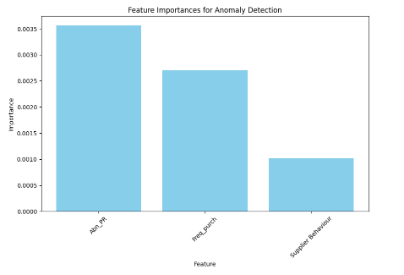
Explainable AI(xAI) with Permutation Importance
S/N | Feature | Condition | Class
1 | Abn_PR | Dead stock, and Net Purchase Requisition (PR) price is >20,000USD | Abnormal (otherwise normal)
2 | Freq_purch | The requested quantity is > twice the current stock quantity and the net price on PO >20,000 USD. | Abnormal (otherwise normal)
3 | Supplier Behavior | Net price on Purchaser Order (PO) is > the net price on the PR by more than 10% of net price on PR | Abnormal (otherwise, normal)
The graph below shows that the ‘Abn_PR’ feature has the highest effect on predicting anomalies in the dataset. This is a featured engineer attributed in the dataset.

Slide 14
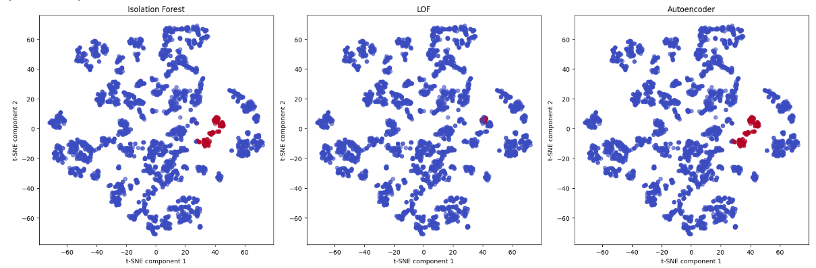
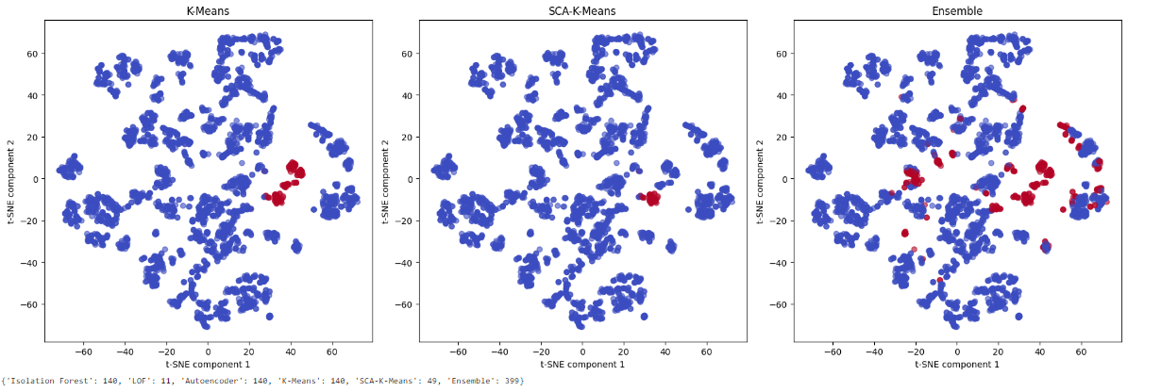
Model Evaluation t-Distributed Stochastic Neighbour Embedding Plots

Slide 15
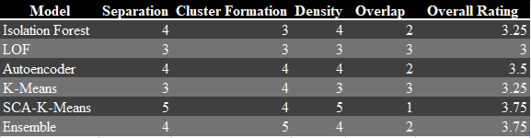
Model Evaluation
To evaluate the performance of each anomaly detection method based on Separation, Cluster Formation, Density, and Overlap, you can create a table that summarizes these aspects. Here’s how you can create and interpret such a table:
Separation: How well the anomalies are separated from normal points.
Cluster Formation: How well the anomalies form distinct clusters.
Density: How dense the clusters of anomalies are.
Overlap: The amount of overlap between anomalies and normal points.
Explanation:
Isolation Forest: Good at separating anomalies from normal points, but with some overlap and less distinct cluster formation.
LOF: Moderate performance in all criteria.
Autoencoder: Good separation and density, forming distinct clusters but with some overlap.
K-Means: Good cluster formation but moderate in other aspects.
SCA-K-Means: Excellent separation and density with minimal overlap, making it highly effective.
Ensemble: Combines strengths of individual models, resulting in good overall performance.

Slide 16
Conclusion
The project aimed to developing a labeled dataset using various anomaly detection models, including Isolation Forest, Local Outlier Factor (LOF), Autoencoder, K-Means, and Sine Cosine Algorithm (SCA)-optimized K-Means, as well as an ensemble method. We evaluated the models based on criteria such as Separation, Cluster Formation, Density, and Overlap using T-SNE. Additionally, permutation importance was used to add an explainable AI component to our analysis. The business and stakeholders will now decide on the dataset that will be used to trained an AI-powered model to classify future Purchase Requisitions as normal or abnormal before creating a Purchased Order for external procurement. As a result, the model will aid to proactively manage risk in our procurement process.

Slide 17
Next Steps
Meet with stakeholders to decided on the most suitable dataset
Develop an AI-powered anomaly detection agent for proactive risk management in our procurement process.
The model will include an anomaly severity ranking score from which auditors will decide on the next action to take.
References
[1] Liu, F. T., Ting, K. M., & Zhou, Z.-H, (2008). "Isolation Forest". In IEEE International Conference on Data Mining.
[2] Breunig, M. M., Kriegel, H.-P., Ng, R. T., & Sander, J. (2000). "LOF: Identifying Density-Based Local Outliers". In Proceedings of the 2000 ACM SIGMOD International Conference on Management of Data.
[3] An, J., & Cho, S. (2015). "Variational Autoencoder based Anomaly Detection using Reconstruction Probability". In Technical Report.
[4] Clustering-Based Anomaly Detection using K-Means. Fahim, A. M., Salem, A. M., Torkey, F. A., & Ramadan, M. A. (2006). "An Efficient Enhanced K-means Clustering Algorithm". In Journal of Zhejiang University Science.
[5] Sine Cosine Algorithm for Optimization. Mirjalili, S, (2016). "SCA: A Sine Cosine Algorithm for Solving Optimization Problems". In Knowledge-Based Systems.
[6] Permutation Importance for Explainable AI. Breiman, L. (2001)."Random Forests". In Machine Learning.
[7] t-Distributed Stochastic Neighbour Embedding (t-SNE).Van der Maaten, L., & Hinton, G,(2008). "Visualizing Data using t-SNE". In Journal of Machine Learning Research.
[8] Jonas Schnepf, Bernd Scheuermann, Paula Vetter.(2023 Analyzing Data Sets for ML-driven Fraud Detection in SAP Systems. IEEE Big Data.
[9] J. Tritscher, F. Gwinner, D. Schlör, A. Krause, and A. Hotho ,(2022).Open ERP System Data for Occupational Fraud Detection 10.48550/arXiv.2206.04460.

Slide 18

Thank you

